Slide 1

Choores
Project in Progress
Steve Berthiaume

Slide 2
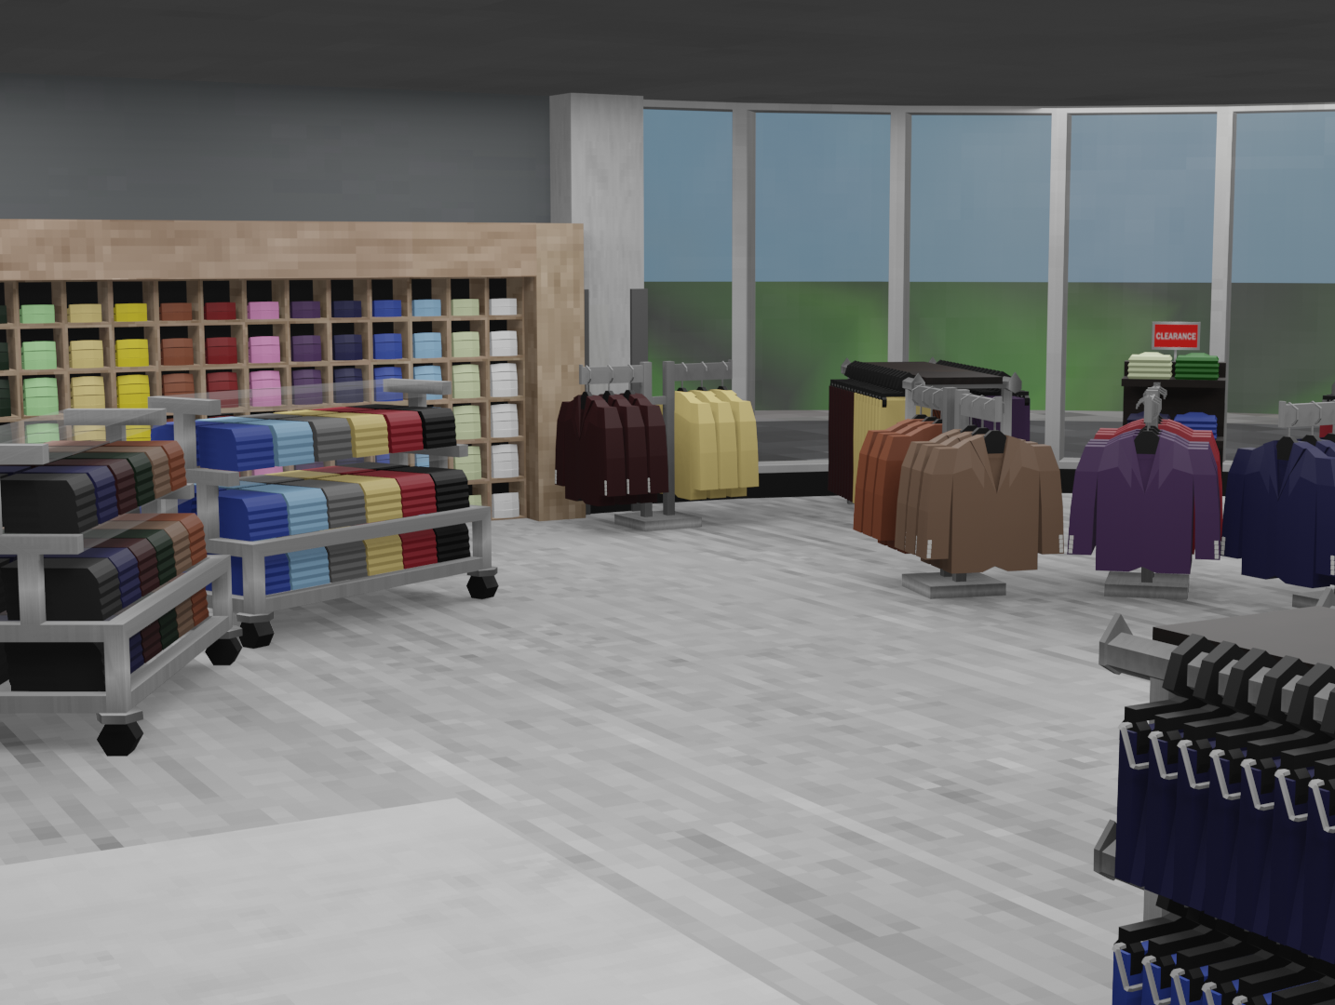
Scene Progress
The majority of my time working on this project has gone towards the 3D scene of a workplace, making it the key thing to discuss for this report.

Slide 3
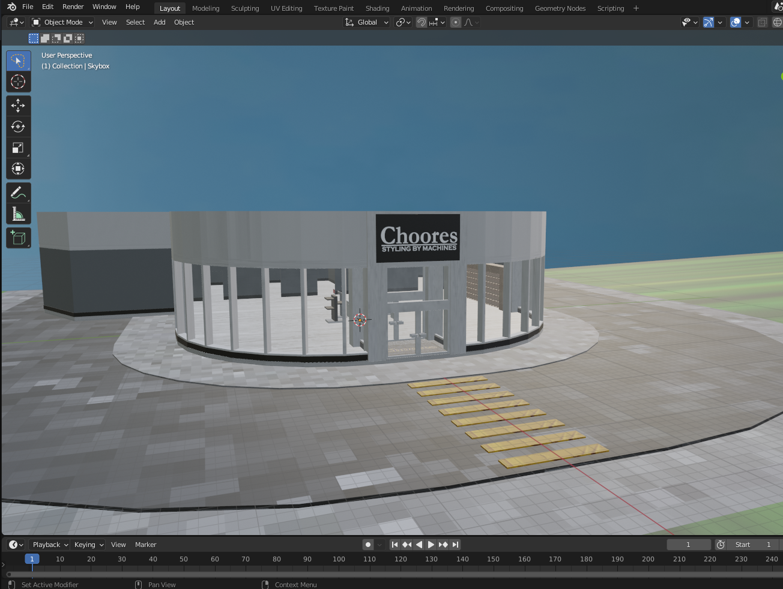
Initial Process
I began with the architecture of the store itself, building the walls and basic shape for each room.

Slide 4
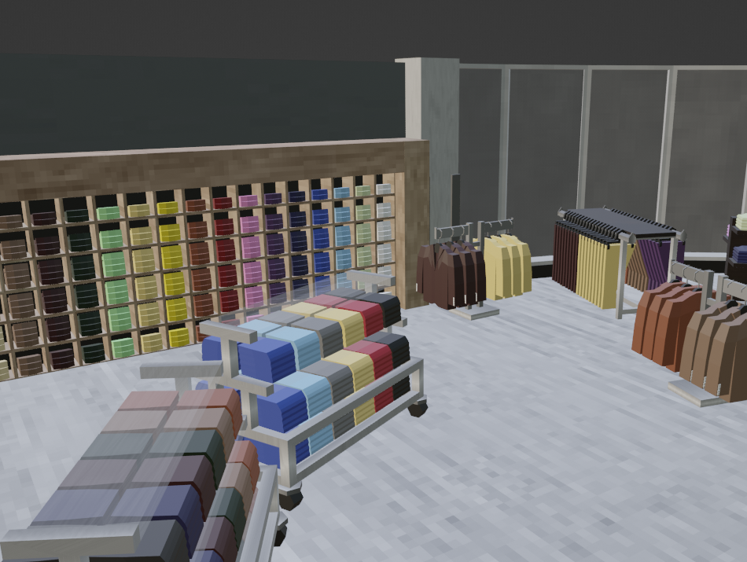
First Steps
In order to give the scene the proper feel, much of my early process revolved around a faithful recreation of the kinds of fixtures found in my actual workplace – tables, racks, etc.

Slide 5
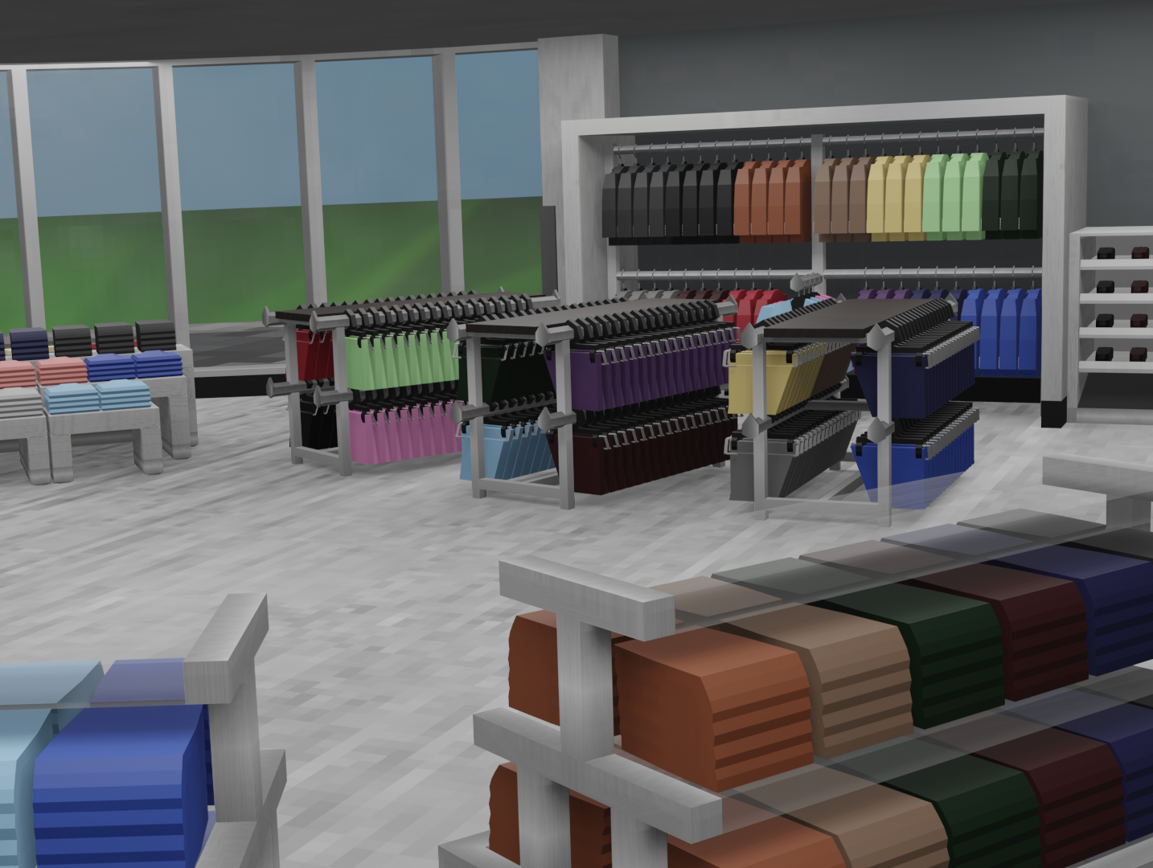
Store Floor
Through my process of adding various fixtures reminiscent of a real environment, the scene began to resemble not my exact workplace, but a possibility for a place that could exist.

Slide 6
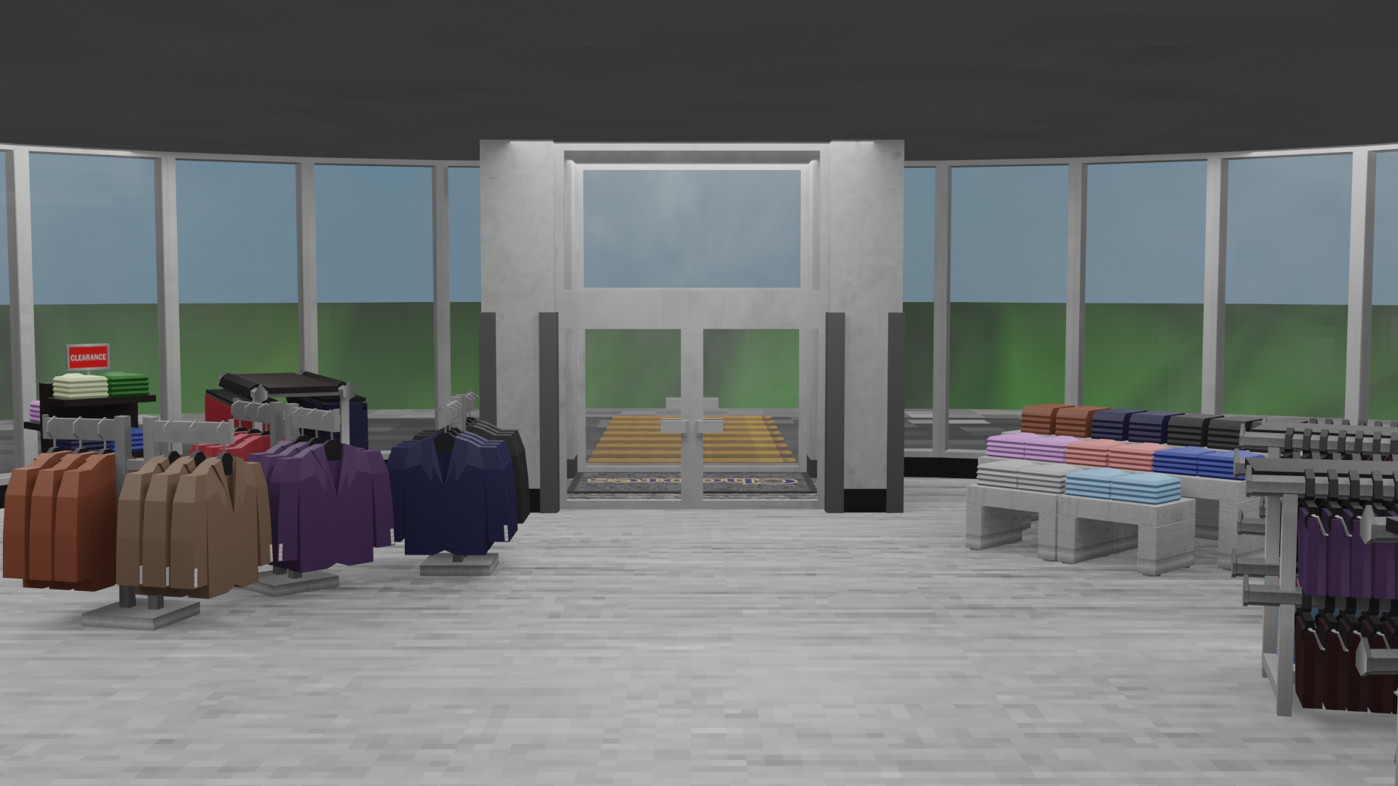
STORE fLOOR

Slide 7
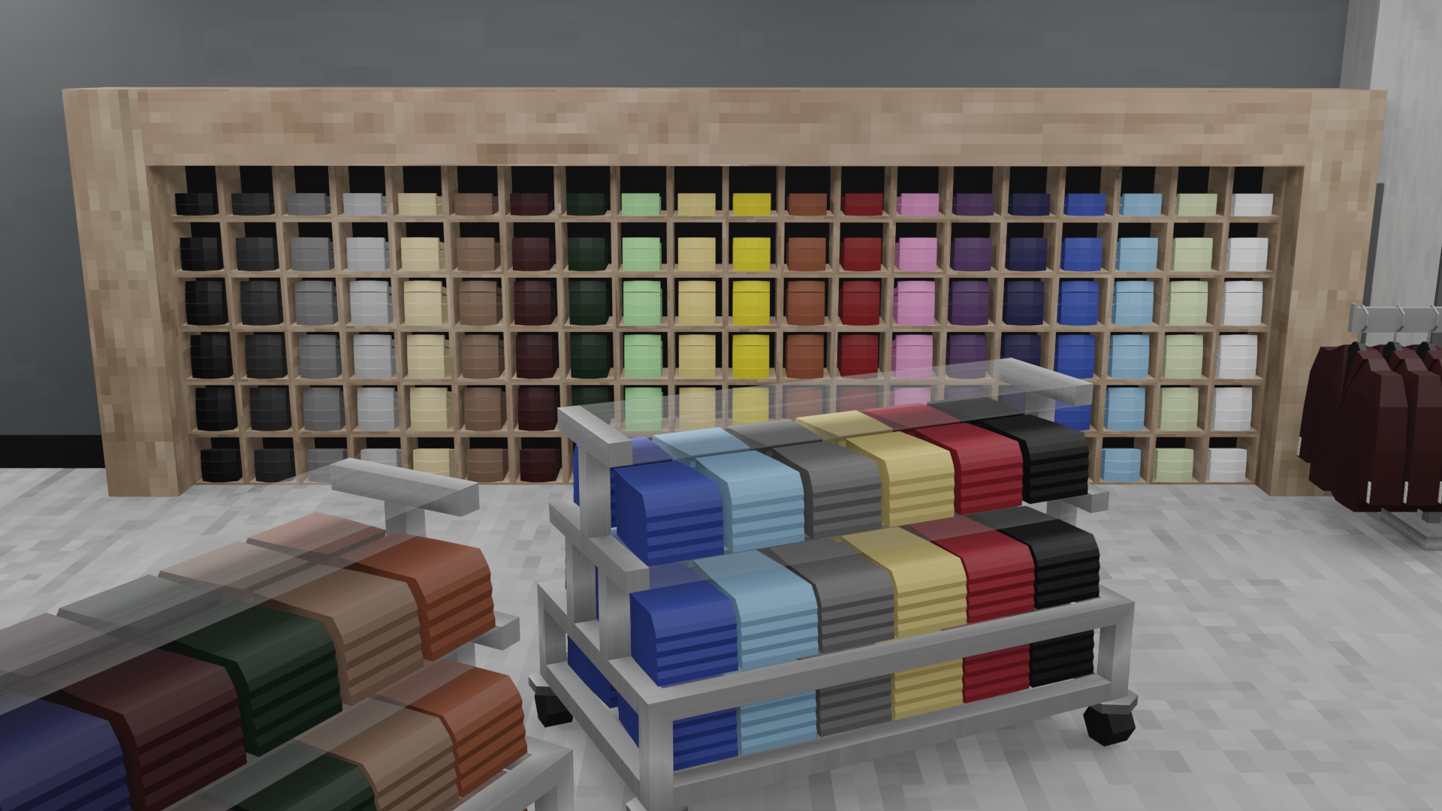
STORE FLOOR

Slide 8
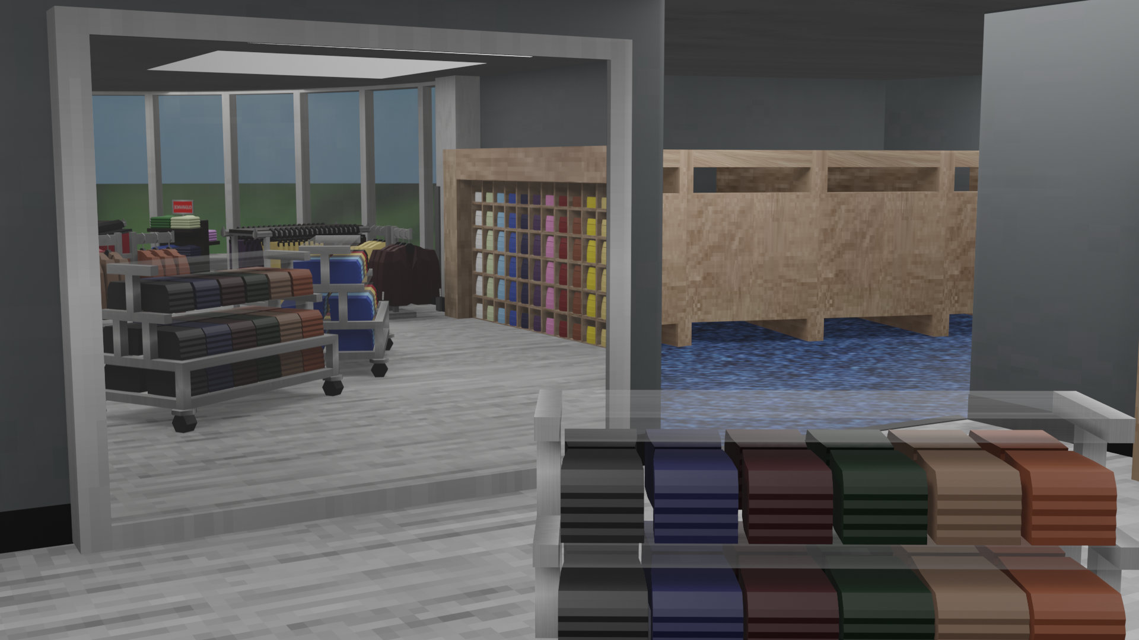
STORE FLOOR

Slide 9
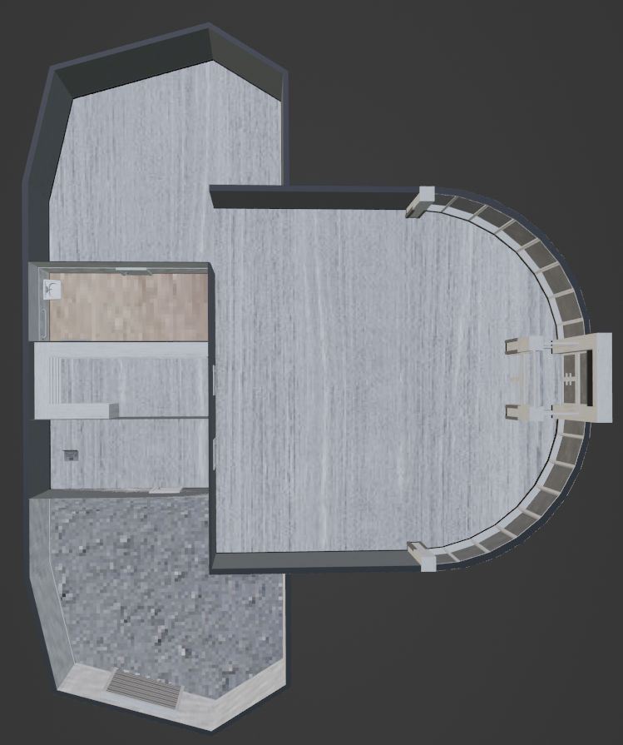
Secondary Locations
Once the most important part of the project was ready, I moved on to the additional locations which would be featured in-game; the Changing Rooms, Bathroom, Backstore, Office and Dock.

Slide 10
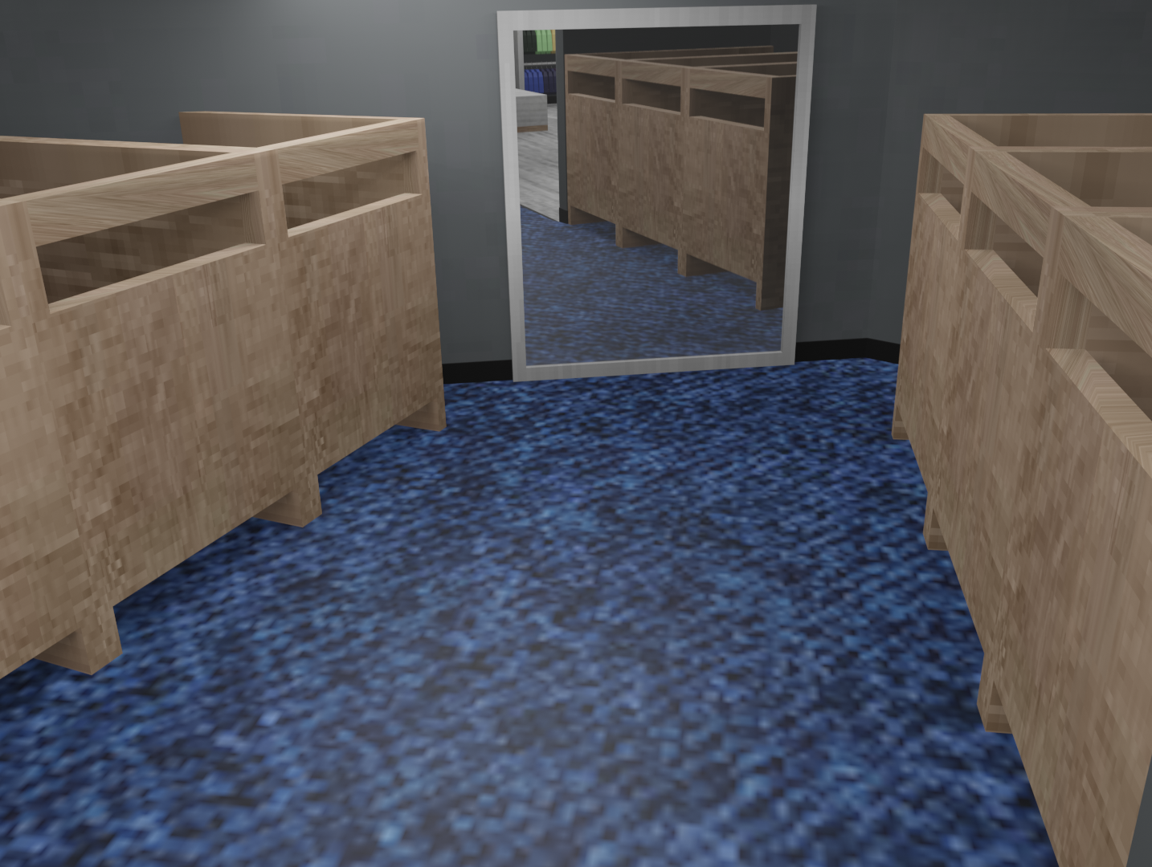
Secondary Locations
I began with the changing rooms, as they are connected to the main store floor. This is when I added the mirrors to the scene as a whole, using ReflectionPlanes.

Slide 11
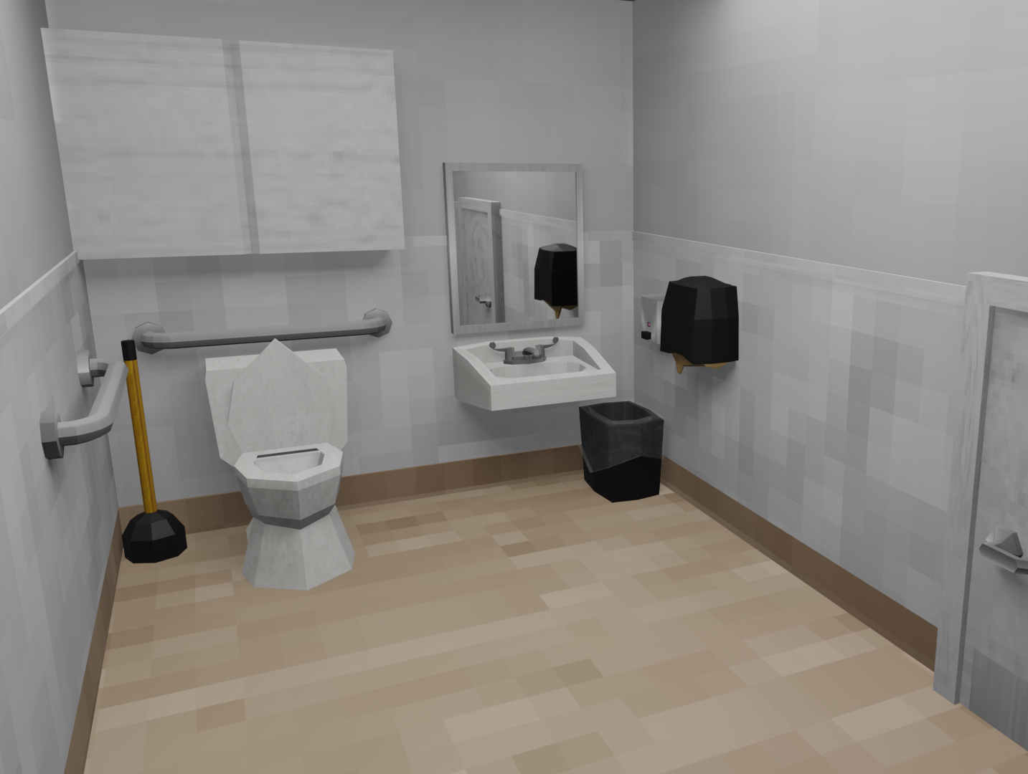
Layout Revision
Working on the bathroom next, I realized that the view of the scene would look more complete with the door in frame, so I revised the blueprints accordingly.

Slide 12
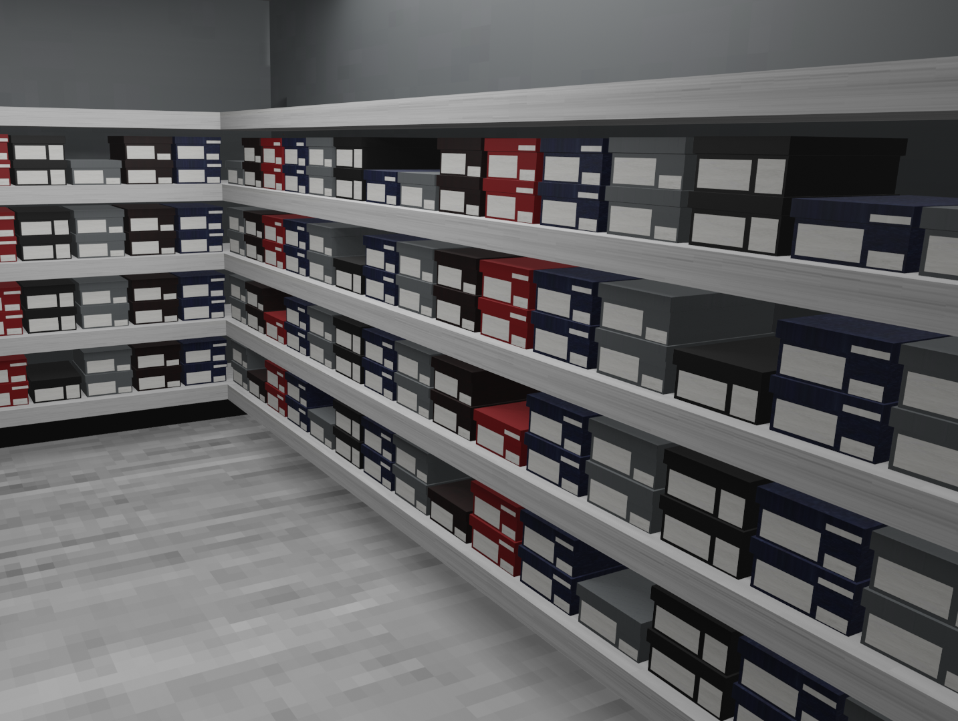
Modelling Wrapup
I spent an additional week modelling the remaining rooms, making sure to lay them out in a way that would be both realistic and visually interesting.

Slide 13
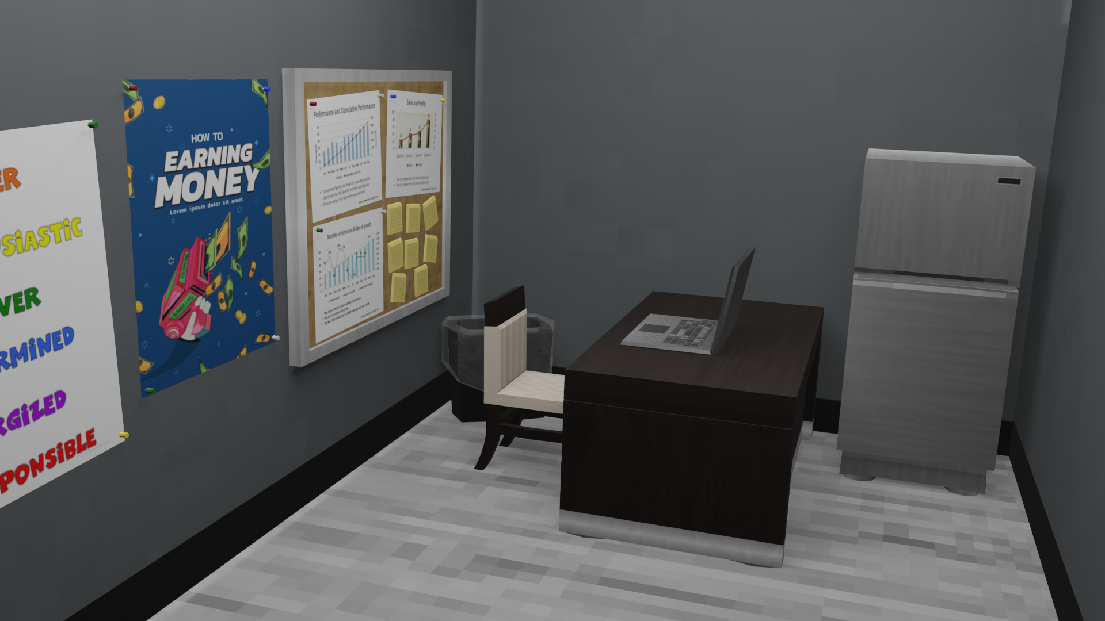
WRAPUP

Slide 14
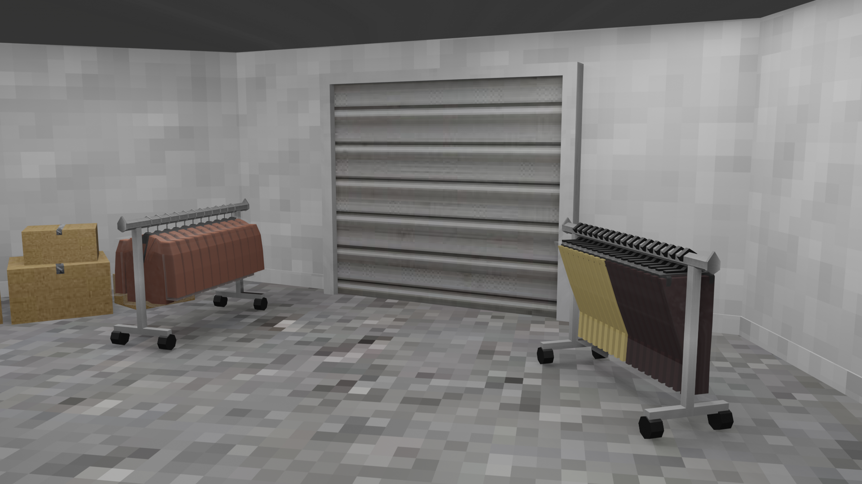
WRAPUP

Slide 15
Current Stage
At present, the bulk of modelling work is done, with only the implementation of simple character models remaining on that front.
This leaves the game itself to complete, though the feasibility of a full game’s completion in an unfamiliar engine in this timeframe is increasingly unconvincing. As such, I may pivot the project’s output form as to make it more realistic and practical, though the direction for this is as yet unclear to me.

